Slide 1
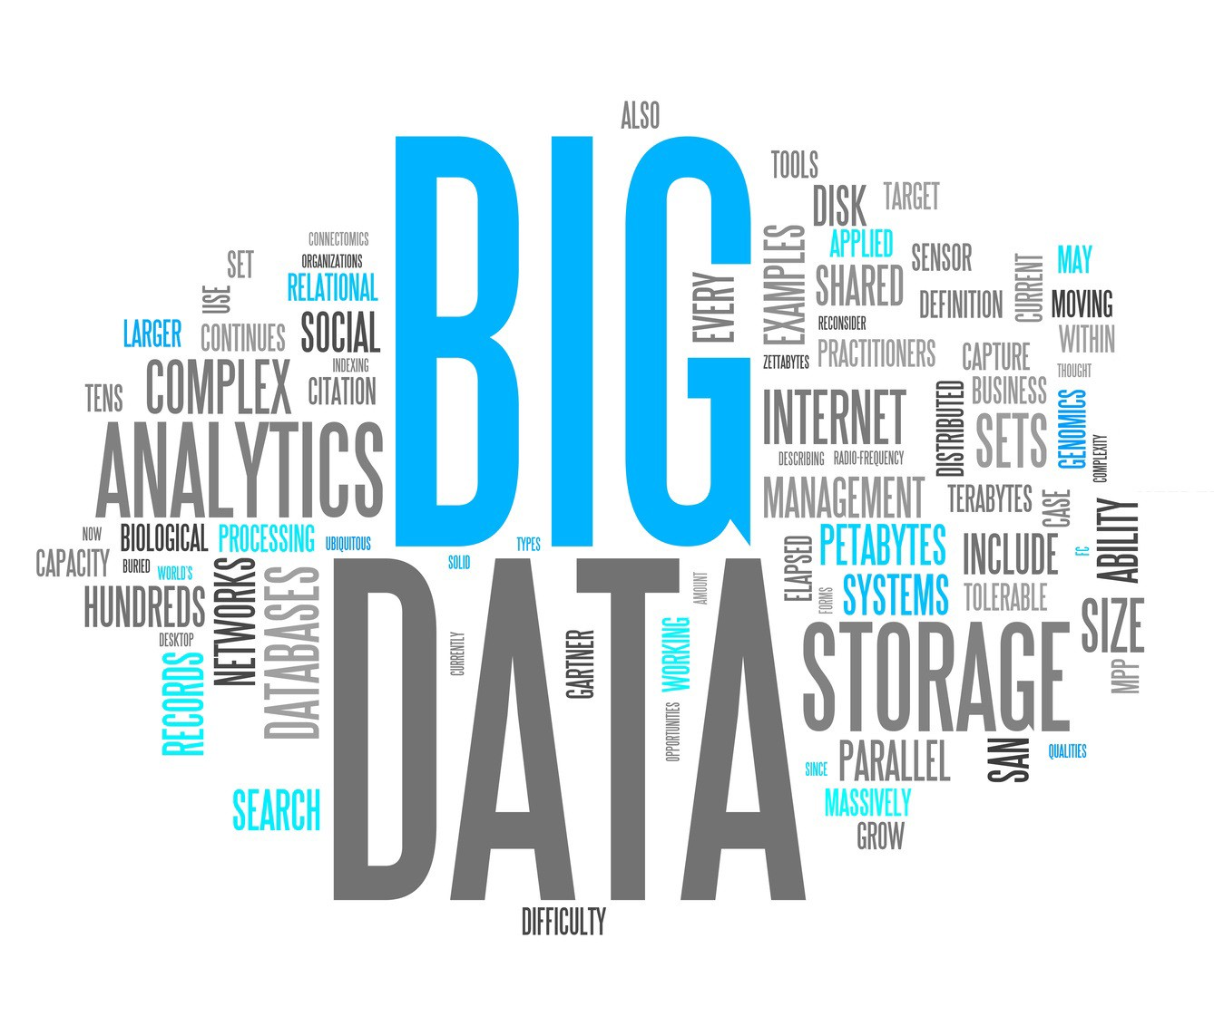
Unsupervised Learning
STAT 474 – Techniques for Large Data Set
Notes:
Are your classroom colors different than what you see in this template? That’s OK! Click on Design -> Variants (the down arrow) -> Pick the color scheme that works for you!
Feel free to change any “You will…” and “I will…” statements to ensure they align with your classroom procedures and rules!

Slide 2
Machine Learning and Data Mining
A large collection of ML/DM is supervising methods.
Big idea: Predict the values of the response using some function of available predictors.
Supervised methods build models based on the data set with both responses and predictors.
Example: Regression models, tree-based models (for small to medium data), neural network and deep learning (large data sets)
More relevant in text analysis, we don’t have a response, things get a little messier…
Very large dimension (i.e., dimension = total number of unique tokens in the data set)

Slide 3
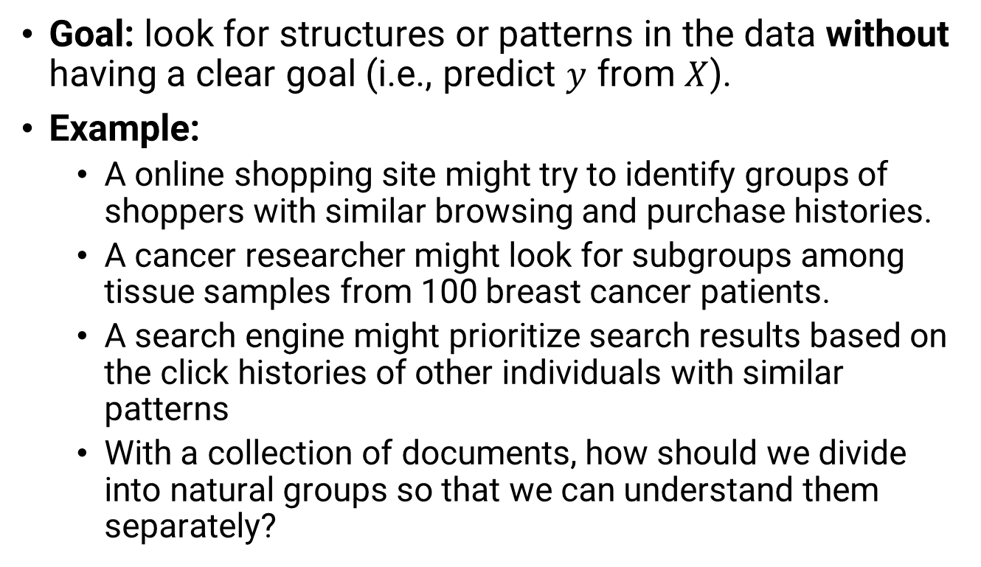
Unsupervised Methods
Goal: look for structures or patterns in the data without having a clear goal (i.e., predict $y$ from $X$).
Example:
A online shopping site might try to identify groups of shoppers with similar browsing and purchase histories.
A cancer researcher might look for subgroups among tissue samples from 100 breast cancer patients.
A search engine might prioritize search results based on the click histories of other individuals with similar patterns
With a collection of documents, how should we divide into natural groups so that we can understand them separately?

Slide 4
Unsupervised method Dimensionality Reduction
Typically, a document is represented by a very high-dimensional vector, up to 10,000s coordinates.
High-dimensionality is not bounded in the context of text analysis, but a very common issue in most of the current data science project.
Your smartphone apps collect a lot of personal information about you.
Amazon collects data of what you buy, view, click, etc. on their site.
Casinos record every move each customer makes.
The process of reducing the number of features or variables that would be used in the analysis is called dimensionality reduction.

Slide 5
Why is Dimensionality reduction required?
Each observation (or document in the text analysis context) lives in high-dimensional space, but not all dimensions are equally interesting.
Space required to store the data is reduced as the number of dimensions comes down
Less dimensions lead to less computation/training time
It helps in visualizing data. It is very difficult to visualize data in higher dimensions so reducing our space to 2D or 3D may allow us to plot and observe patterns more clearly
Some algorithms/methods do not perform well when we have a large dimensions. So reducing these dimensions is required when using the algorithms

Slide 6
Common techniques for dimensionality reduction
Techniques can be roughly grouped into 2 categories:
Only keep the most relevant variables (feature selection)
Find a smaller set of new variables (derived from the original ones) containing roughly the same info.
Missing Value Ratio: remove variables that have too many missing values.
Rule of thumb (but not set in stone): any variable with more than 50% missing value
Not applicable for text mining as there is no missing values for document-term matrices.

Slide 7
Common techniques for dimensionality reduction
Low variance Filter: Variable with low variance tends to have very low impact on the target variable (response)
Extreme example: All the observations have the same value, say 1.
But, in text mining, author detection takes advantage of rare appearance of rare words.
Example: anonymous NYT op-ed article in 2017: “I Am Part of the Resistance Inside the Trump Administration” by "senior official in the Trump administration"
Rare words: "malign behavior", "lodestar"

Slide 8
Common techniques for dimensionality reduction
High Correlation Filter: High correlation between two variables means they have similar trends and are likely to carry similar information.
If the correlation coefficient crosses a certain threshold value, we can drop one of the variables
Dropping a variable is highly subjective and should always be done keeping the domain in mind
As a general guideline, we should keep those variables which show a decent or high correlation with the target variable.
Might be applicable in text analysis, depending on the goal of the project, e.g., topic modeling versus text classification

Slide 9
Common techniques for dimensionality reduction
Forward Selection and Backward Elimination: Very popular in modeling.
Typically associated with linear regression or logistic regression models.
Dropping/Adding variables one at a time depends on their effect on the response.
Factor Analysis: Variability among high-dimensional observations correlates with a lower number of unobserved variables called factor (or latent variables)
Developed in psychology for measuring intelligence.
Text analysis equivalent technique is call topic modeling

Slide 10
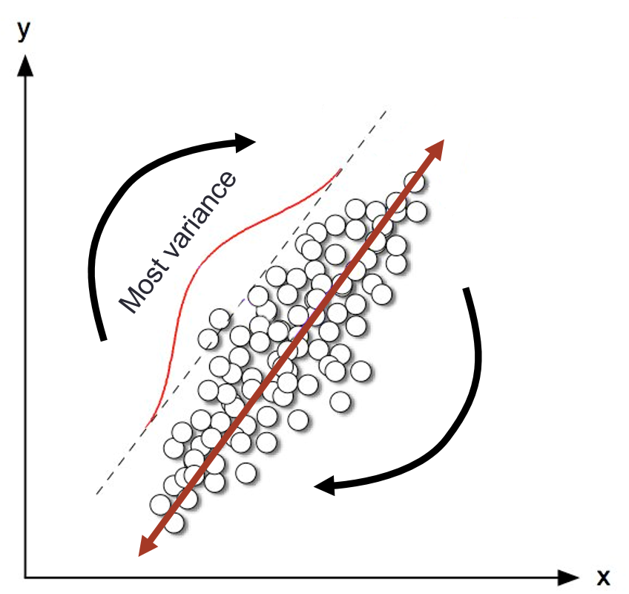
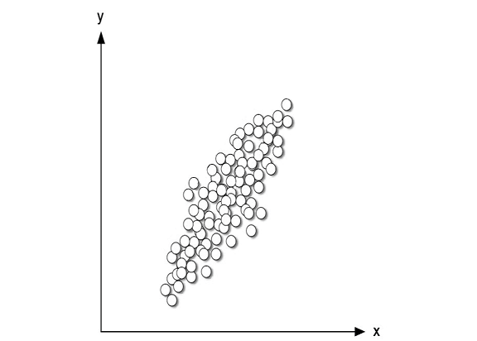
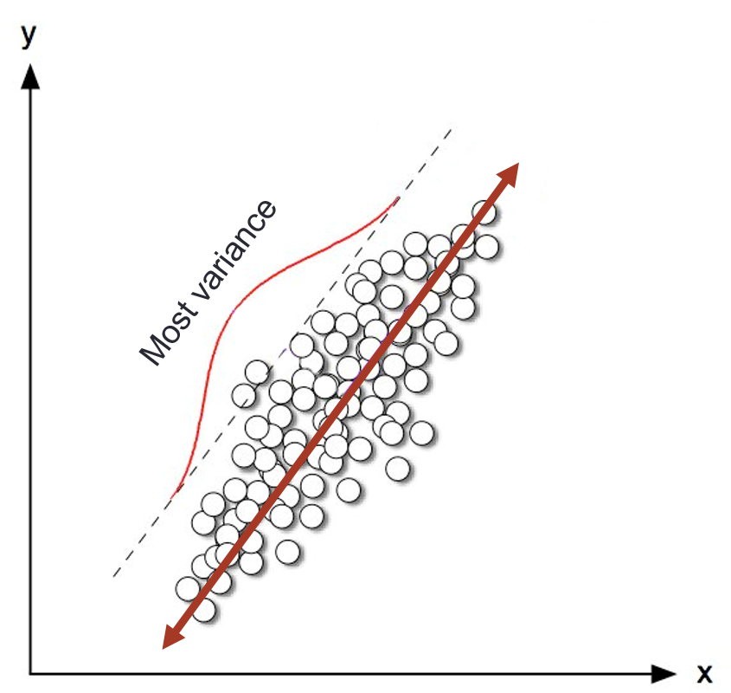
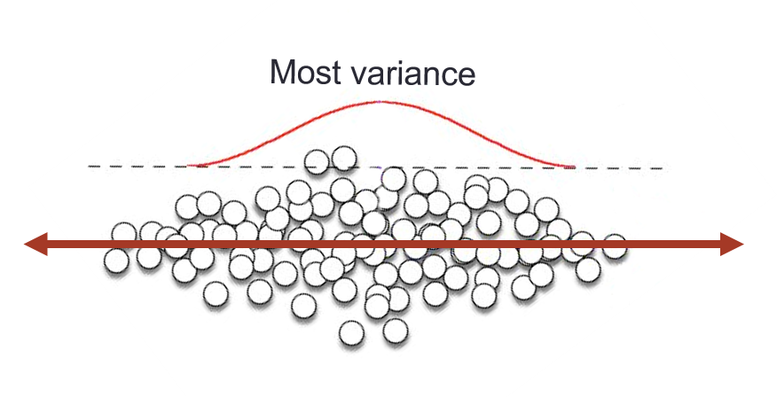
Principal Component Analysis

Slide 11
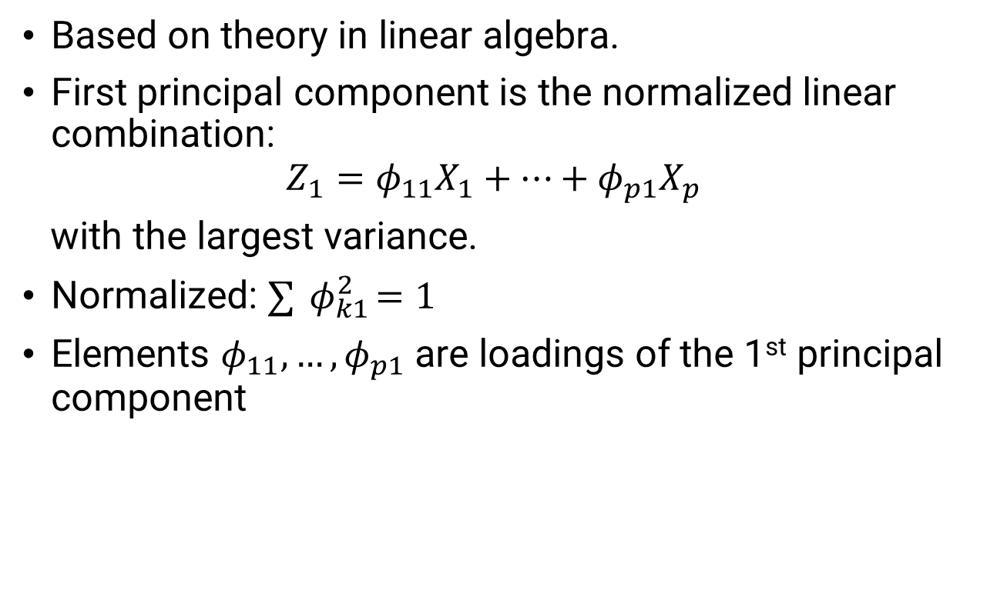
Principal Component Analysis
Based on theory in linear algebra.
First principal component is the normalized linear combination: $Z_{1}=φ_{11}X_{1}+⋯+φ_{p1}X_{p}$
with the largest variance.
Normalized: $∑{ φ}_{k1}^{2}=1$
Elements $φ_{11},…,φ_{p1}$ are loadings of the 1st principal component

Slide 12
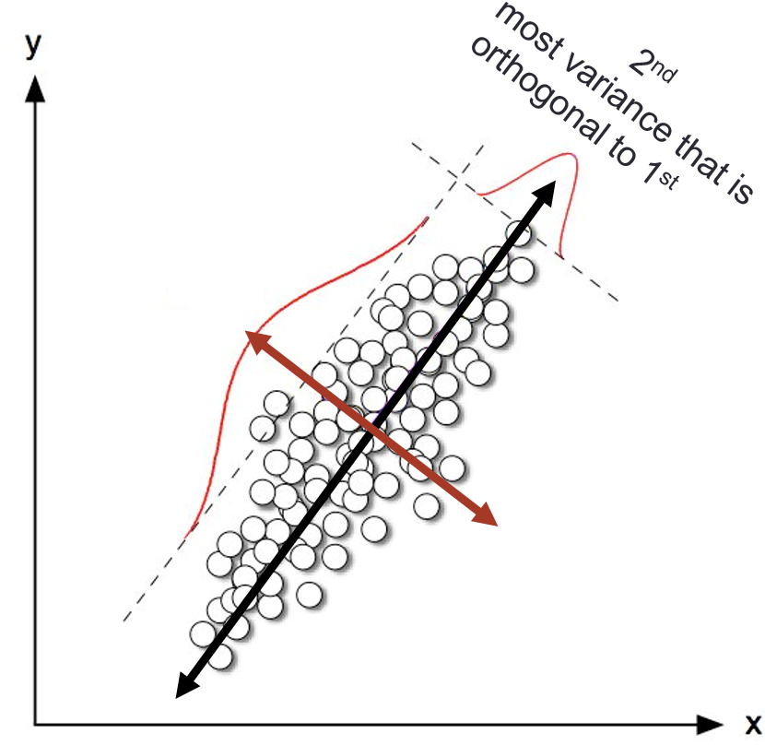
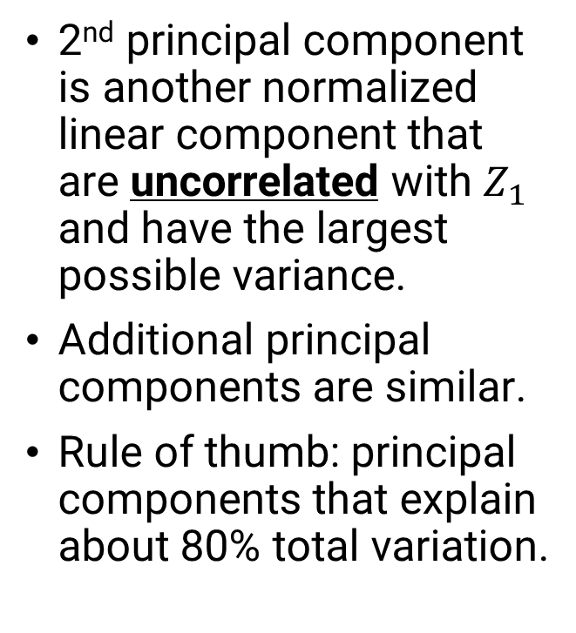
Principal Component Analysis
2nd principal component is another normalized linear component that are uncorrelated with $Z_{1}$ and have the largest possible variance.
Additional principal components are similar.
Rule of thumb: principal components that explain about 80% total variation.

Slide 13
Important details: Scaling
Variables are measured in different units; therefore, some of them have very different variance.
If we perform PCA on the unscaled variables, the 1st principal loading vector will highly weigh these variables
To avoid this, we typically scale each variable to have standard deviation of 1.
If variables are not centered, the first principal component is (typically) the vector of the means
If an important trend direction is close to the mean vector, the PCA can't detect (Why?)
Centering is required most of the time.

Slide 14
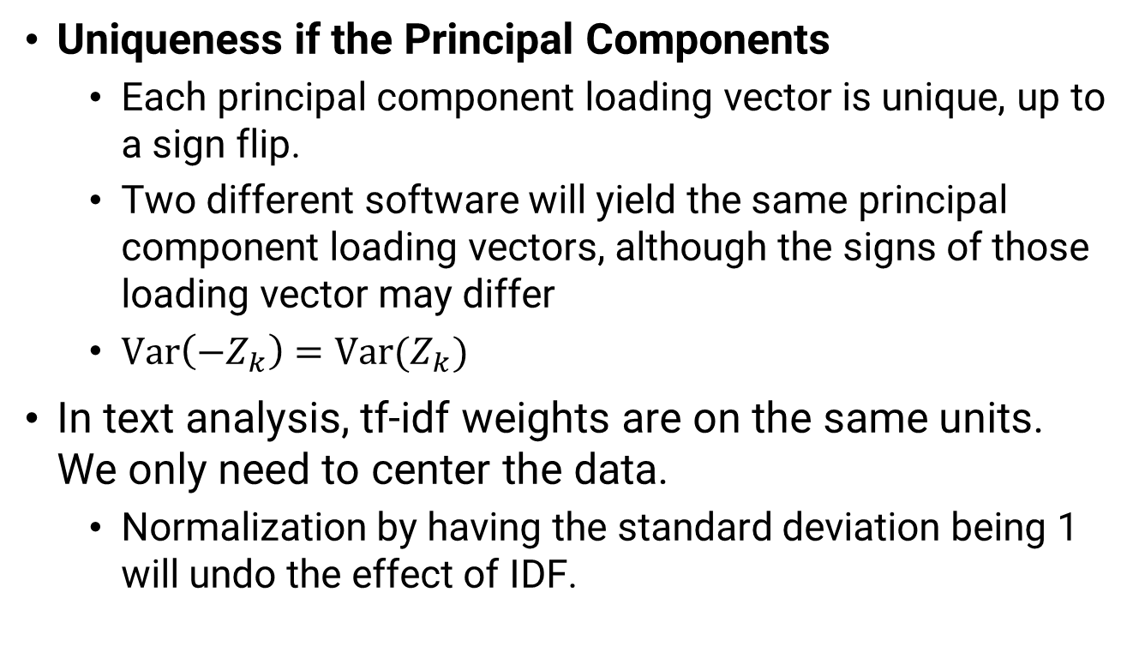
Important details
Uniqueness if the Principal Components
Each principal component loading vector is unique, up to a sign flip.
Two different software will yield the same principal component loading vectors, although the signs of those loading vector may differ
$\text{Var}\left(−Z_{k}\right)=\text{Var}(Z_{k})$
In text analysis, tf-idf weights are on the same units. We only need to center the data.
Normalization by having the standard deviation being 1 will undo the effect of IDF.

Slide 15
Unsupervised Method Clustering
Big idea: partition observations into distinct groups such that
observations within each group are similar to each other
observations in different groups are different from each other
What we need: a clear idea of what it means for two or more observations to be similar or different
This is usually a domain-specific consideration that must be made based on additional knowledge of the data.
Question: If I have two documents, how did I know that they are similar without reading both?

Slide 16
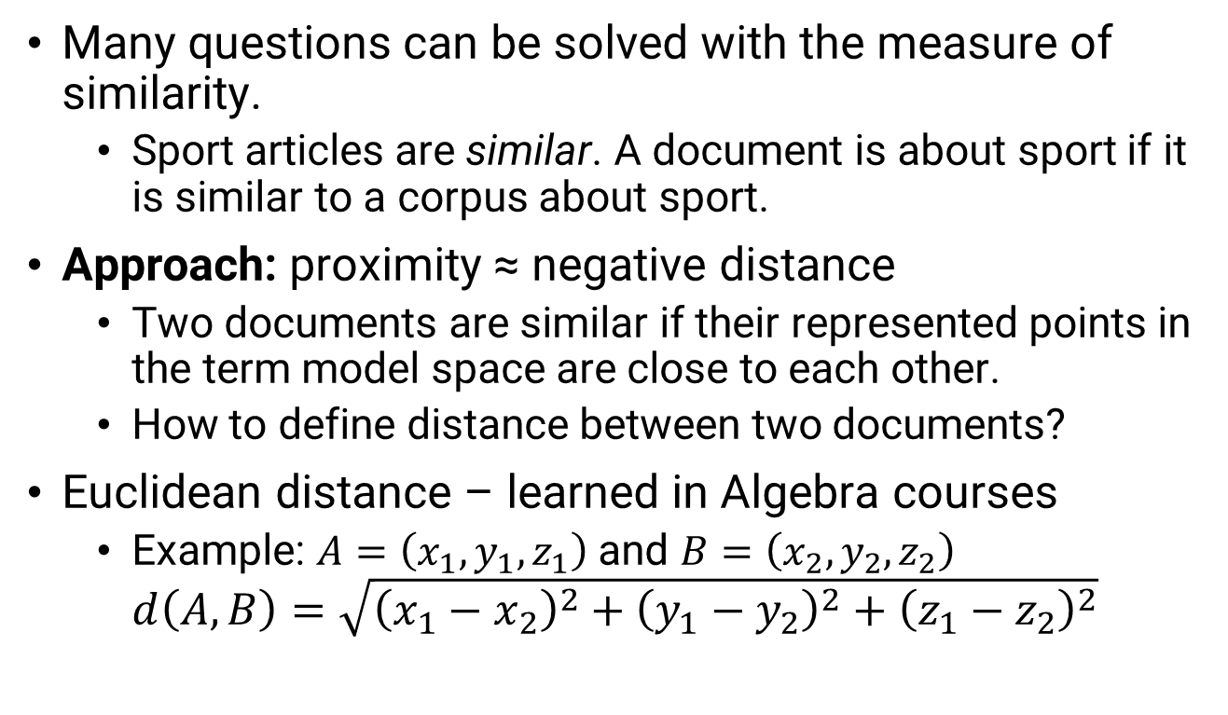
How to measure the similarity?
Many questions can be solved with the measure of similarity.
Sport articles are similar. A document is about sport if it is similar to a corpus about sport.
Approach: proximity ≈ negative distance
Two documents are similar if their represented points in the term model space are close to each other.
How to define distance between two documents?
Euclidean distance – learned in Algebra courses
Example: $A=\left(x_{1},y_{1},z_{1}\right)$ and $B=\left(x_{2},y_{2},z_{2}\right)$
$$d\left(A, B\right)=\sqrt{{\left(x_{1}−x_{2}\right)}^{2}+{\left(y_{1}−y_{2}\right)}^{2}+{\left(z_{1}−z_{2}\right)}^{2}}$$

Slide 17
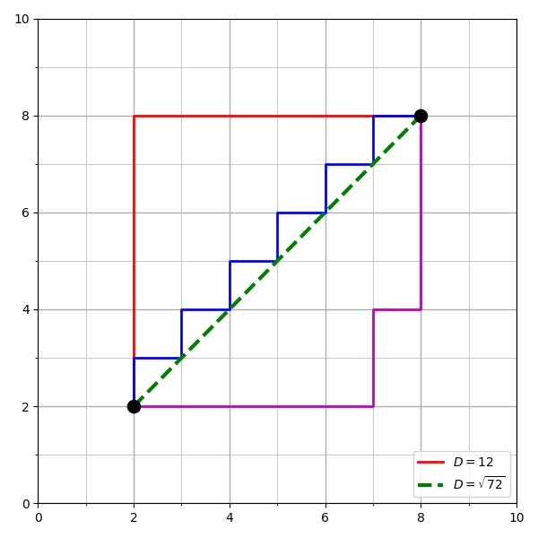

Distance Metrics
Euclidean distance.
Manhattan distance.
$$d\left(A,B\right)=\left|x_{1}−x_{2}\right|+\left|y_{1}−y_{2}\right|+|z_{1}−z_{2}|$$

Slide 18
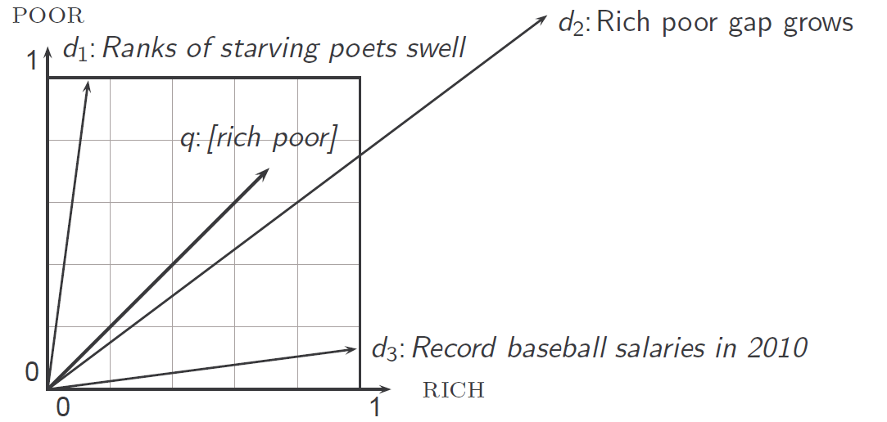
Why distance is a bad idea
Euclidean distance is large for vectors of different lengths.

Slide 19
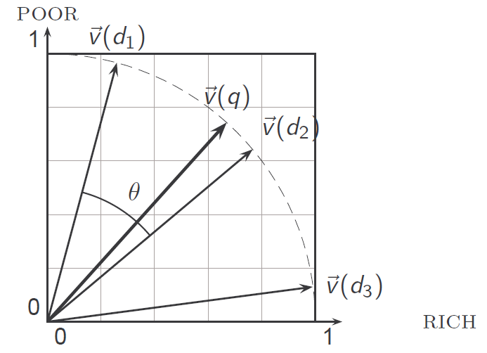

Use angle instead of distance
Use the cosine of the angle to measure the similarity.
Cosine is a monotonically decreasing function of the angle for the interval $[0,π]$.
How to compute the cosine? from MATH 222?

Slide 20
Unsupervised Method Clustering
Goal: partition the observations into a pre-specified number of groups
"partition" means that each observation is assigned to exactly one group.
(If time permits) In topic modeling, an document/article can be about two or more topics.
Brainstorming: How should we define a cluster?
Big idea: good clustering = within-cluster variation is as small as possible

Slide 21
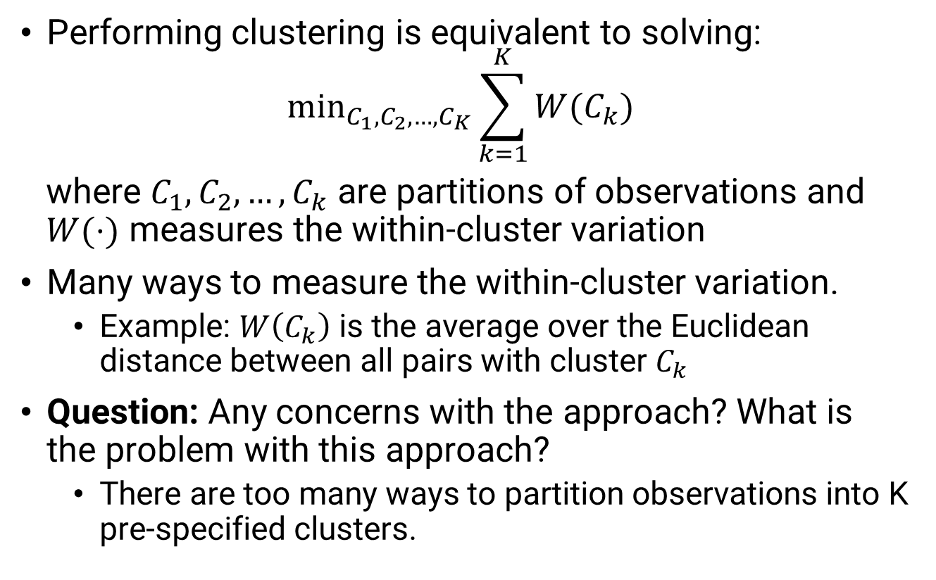
Clustering – A bit of Math
Performing clustering is equivalent to solving:
$${\text{min}}_{C_{1},C_{2},…,C_{K}}\sum_{k=1}^{K}{W(C_{k}) }$$
where $C_{1},C_{2},…,C_{k}$ are partitions of observations and $W(⋅)$ measures the within-cluster variation
Many ways to measure the within-cluster variation.
Example: $W\left(C_{k}\right)$ is the average over the Euclidean distance between all pairs with cluster $C_{k}$
Question: Any concerns with the approach? What is the problem with this approach?
There are too many ways to partition observations into K pre-specified clusters.

Slide 22
K-means Algorithm
A very simple algorithm can be shown to provide a "pretty good" solution (frequently used in practice).
Algorithm:
Randomly assign a number, from 1 to K, to each of the observations. These served as initial cluster assignments for the observations.
Iterate until the cluster assignments stop changing:
Compute the vector of the feature means for the observation in the k-th cluster (this is called the centroid)
Assign each observation to the cluster whose centroid is closest (where "closest" is defined using Euclidean distance)

Slide 23
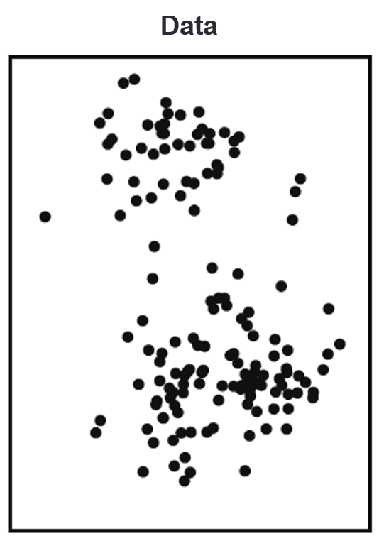
K-means Example – K = 3

Slide 24
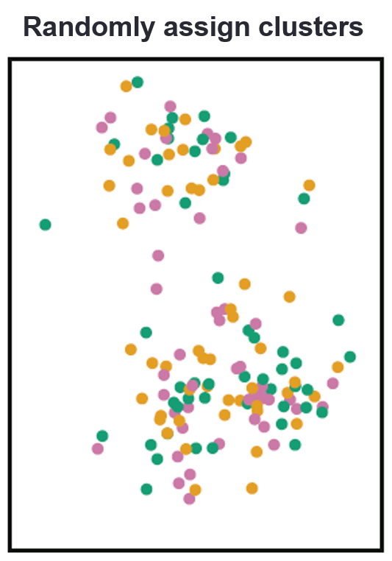
K-means Example – K = 3

Slide 25
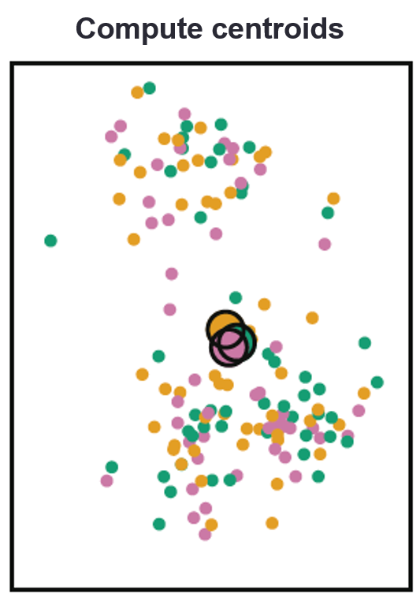
K-means Example – K = 3

Slide 26
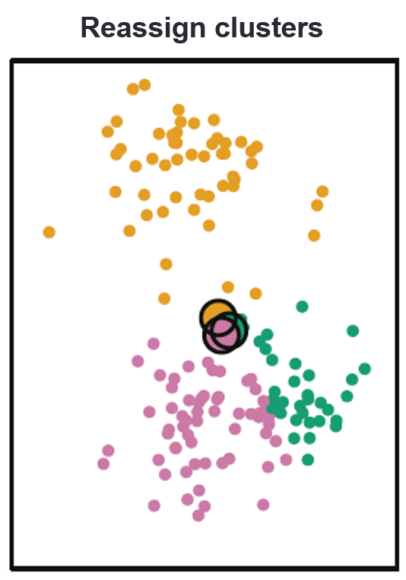
K-means Example – K = 3

Slide 27
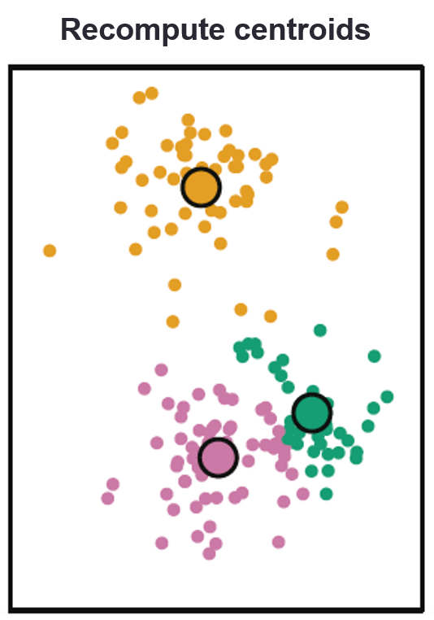
K-means Example – K = 3

Slide 28
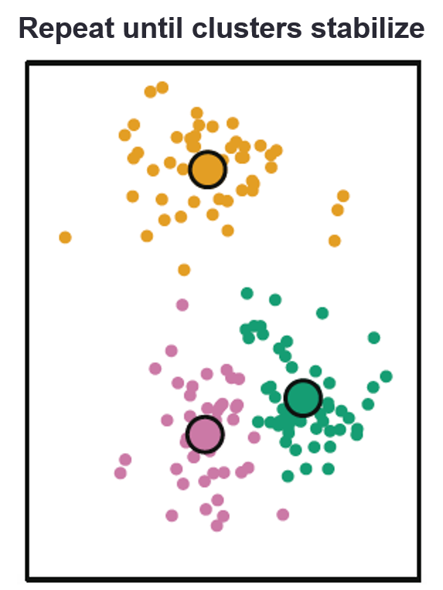
K-means Example – K = 3

Slide 29
K-means Clustering
Question: Why does the K-means algorithm work?
Answer:
The process decreases the cluster variation at each step.
For a list of numbers, the mean minimizes the sum of squares (for Euclidean distance)
Note:
K-means algorithm find a local rather than a global best solutions
Due to the initial (random) assignment
In practice: run algorithm multiple times from different initial configurations to avoid getting “stuck”

Slide 30
How to measure the similarity?
Many questions can be solved with the measure of similarity.
Sport articles are similar. A document is about sport if it is similar to a corpus about sport.
Approach: proximity ≈ negative distance
Two documents are similar if their represented points in the term model space are close to each other.
How to define distance between two documents?
Euclidean distance – learned in Algebra courses
Example: $A=\left(x_{1},y_{1},z_{1}\right)$ and $B=\left(x_{2},y_{2},z_{2}\right)$
$$d\left(A, B\right)=\sqrt{{\left(x_{1}−x_{2}\right)}^{2}+{\left(y_{1}−y_{2}\right)}^{2}+{\left(z_{1}−z_{2}\right)}^{2}}$$

Slide 31
Distance Metrics
Euclidean distance.
Manhattan distance.
$$d\left(A,B\right)=\left|x_{1}−x_{2}\right|+\left|y_{1}−y_{2}\right|+|z_{1}−z_{2}|$$

Slide 32
Why distance is a bad idea
Euclidean distance is large for vectors of different lengths.

Slide 33
Use angle instead of distance
Use the cosine of the angle to measure the similarity.
Cosine is a monotonically decreasing function of the angle for the interval $[0,π]$.
How to compute the cosine? from MATH 222?

Slide 34
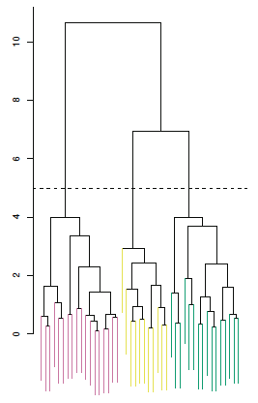
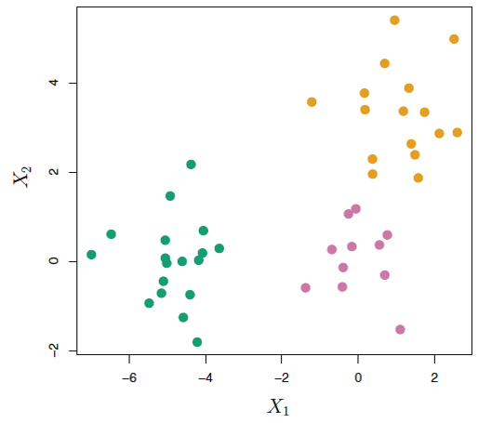
Hierarchical clustering
Big Idea: adapt tree-based methods to perform clustering without having to pre-specify # of clusters

Slide 35
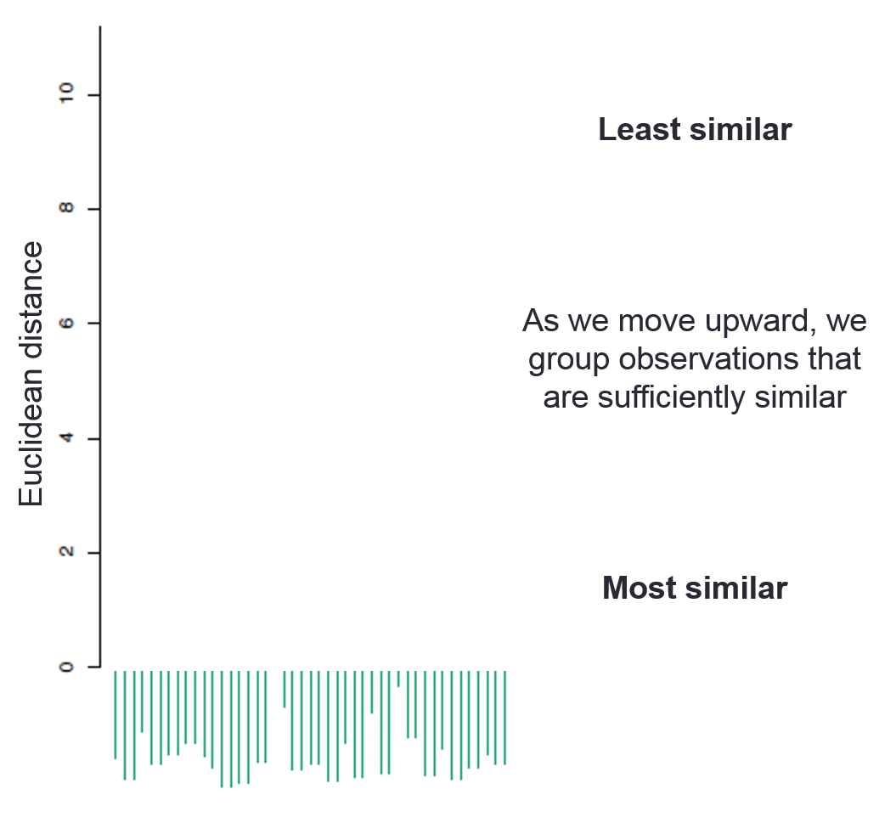
Dendrograms

Slide 36
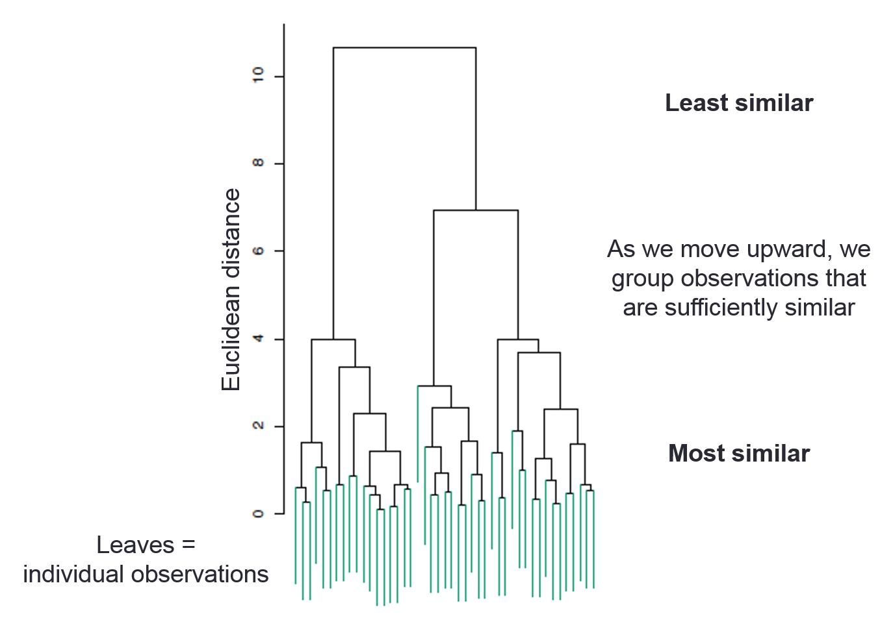
Dendrograms

Slide 37
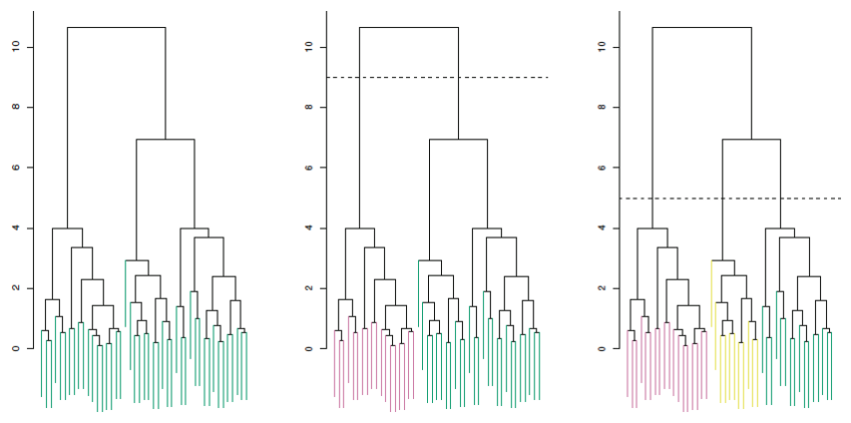
Hierarchical clustering
To go from a dendrogram to actual clusters, just cut!
The height of the cut serves the same role as the K in k-means clustering: it controls the number of clusters.

Slide 38
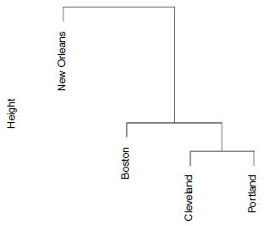
Building the dendrogram
Let's start with a small data set
City | Annual rainfall (in)
Boston | 43.77
Cleveland | 39.14
Portland | 39.14
New Orleans | 62.45

Slide 39
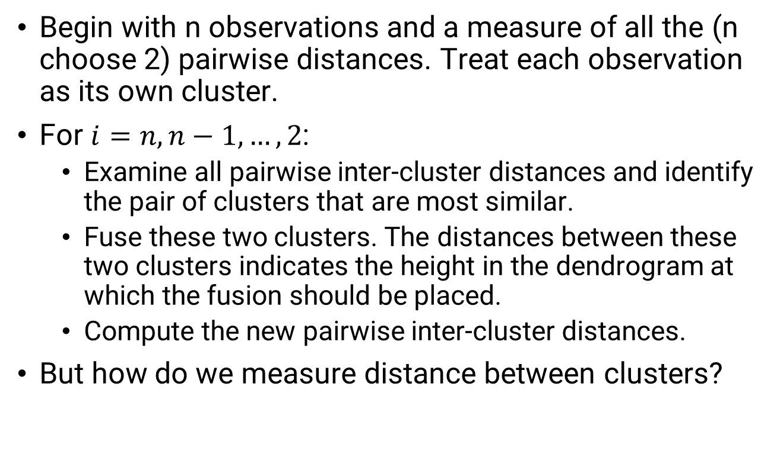
Building the dendrogram
Begin with n observations and a measure of all the (n choose 2) pairwise distances. Treat each observation as its own cluster.
For $i=n,n−1,…,2$:
Examine all pairwise inter-cluster distances and identify the pair of clusters that are most similar.
Fuse these two clusters. The distances between these two clusters indicates the height in the dendrogram at which the fusion should be placed.
Compute the new pairwise inter-cluster distances.
But how do we measure distance between clusters?

Slide 40
Linkage types
Complete: maximal inter-cluster distance (all pairs)
Single: minimal inter-cluster distance (all pairs)
Average: mean inter-cluster distance (all pairs)
Centroid: distance between cluster means (inexpensive, but may result in problematic inversions)
Average, complete = generally more balanced

Slide 41
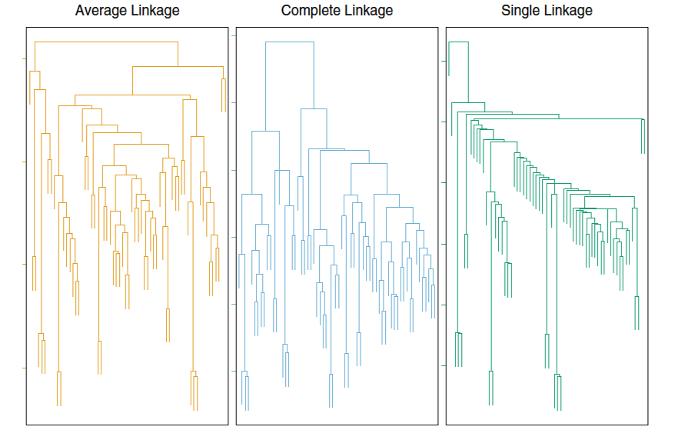
Linkage types

